Slide 1
Aspect-Oriented Software Development (AOSD) is a programming paradigm that focuses on separating and modularizing cross-cutting concerns in software development.
Cross-cutting concerns are functionalities that span multiple components in a program, making them hard to maintain and modularize using traditional methods.

Slide 2
AOSD improves code reusability, maintainability, and readability by enabling developers to encapsulate these concerns into separate units called aspects.

Slide 3
What is a Concern?
The concern is behavior that we want to have in a particular module of an application.
A concern may be defined as a functionality we want to implement.

Slide 4
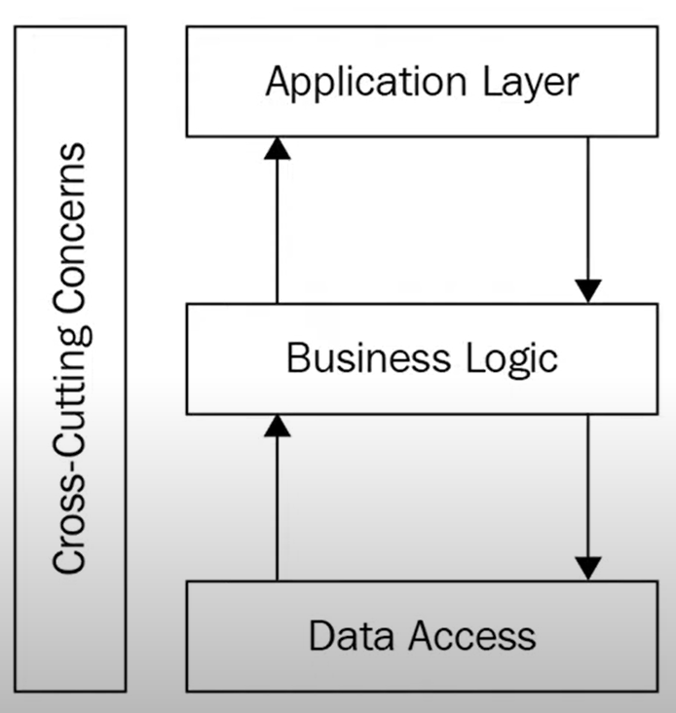

Slide 5
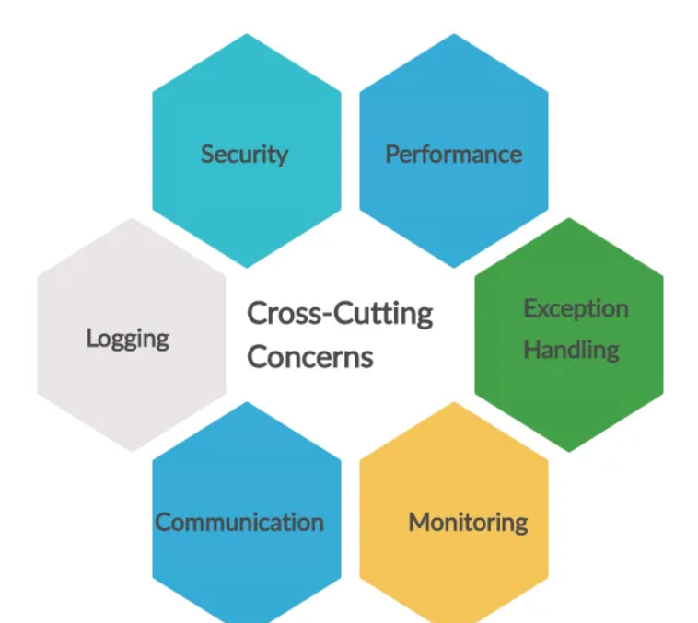

Slide 6
What is cross cutting concern?
The cross-cutting concern is a concern that is applicable throughout the application and it affects the entire application.
Cross-Cutting concerns help you to manage the application level functionalities in a centralized location.

Slide 7
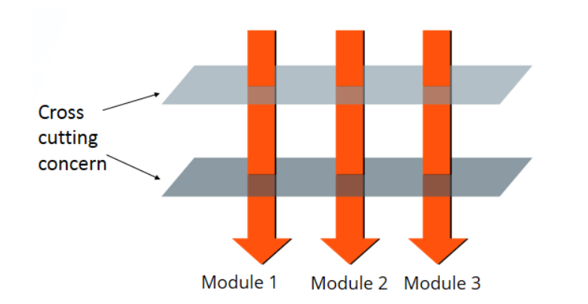

Slide 8
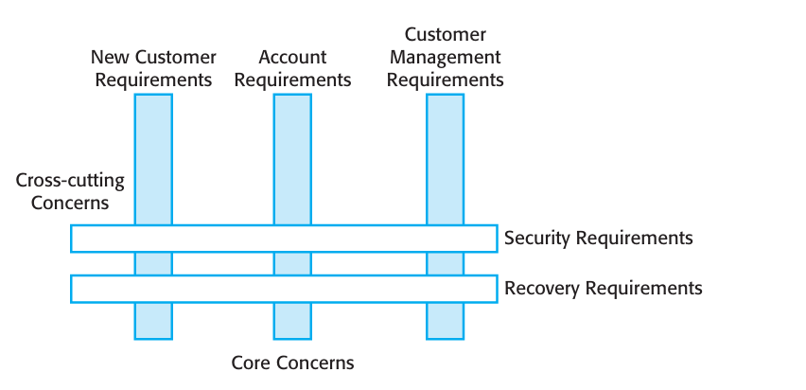

Slide 9
Scaling Agile Method
Agile methods have been mostly used for the development of small and medium-sized systems.
Of course, the need for faster delivery of software, which is more suited to customer needs, also applies to larger systems.
Consequently, there has been a great deal of interest in scaling agile methods to cope with larger systems, developed by large organizations

Slide 10
There are two perspectives on the scaling of agile methods
scaling up perspective, which is concerned with using agile methods for developing large software systems that cannot be developed by a small team.

Slide 11
scaling out perspective, which is concerned with how agile methods can be introduced across a large organization with many years of software development experience.

Slide 12
Agile methods have to be adapted to cope with large systems engineering.
it is essential to maintain the fundamentals of agile methods—flexible planning, frequent system releases, continuous integration, test driven development, and good team communications.
Some critical adaptations that have to be introduced are as follows

Slide 13
1. For large systems development, up-front design and system documentation and also breakdown work across teams.
2 Cross-team communication mechanisms have to be designed and used. – video conferincing
3. Continuous integration and maintain frequent system builds and regular releases of the system.

Slide 14
Some of the problems in scaling-out agile methods in large technology companies are:
1. Project managers who do not have experience of agile methods may be reluctant to accept the risk of a new approach.

Slide 15
2. Large organizations often have quality procedures and standards that all projects are expected to follow.
3. Agile methods seem to work best when team members have a relatively high skill level. However, within large organizations, there are likely to be a wide range of skills and abilities

Slide 16
4. There may be cultural resistance to agile methods, especially in those organizations that have a long history of using conventional systems engineering processes.

Slide 17
Agile project management
Agile project management is an iterative approach to managing software development projects that focuses on continuous releases and incorporating customer feedback with every iteration.
Software teams that embrace agile project management methodologies increase their development speed, expand collaboration, and foster the ability to better respond to market trends.
The Scrum approach is a general agile method but its focus is on managing iterative development rather than specific technical approaches to agile software engineering.

Slide 18
Scrum does not prescribe the use of programming practices such as pair programming and test-first development.
It can therefore be used with more technical agile approaches, such as XP, to provide a management framework for the project

Slide 19
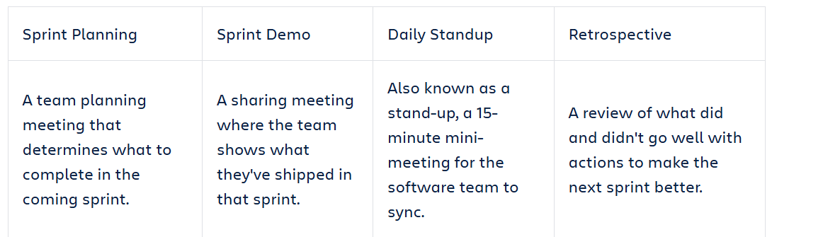
Some ceremonies of Scrum

Slide 20
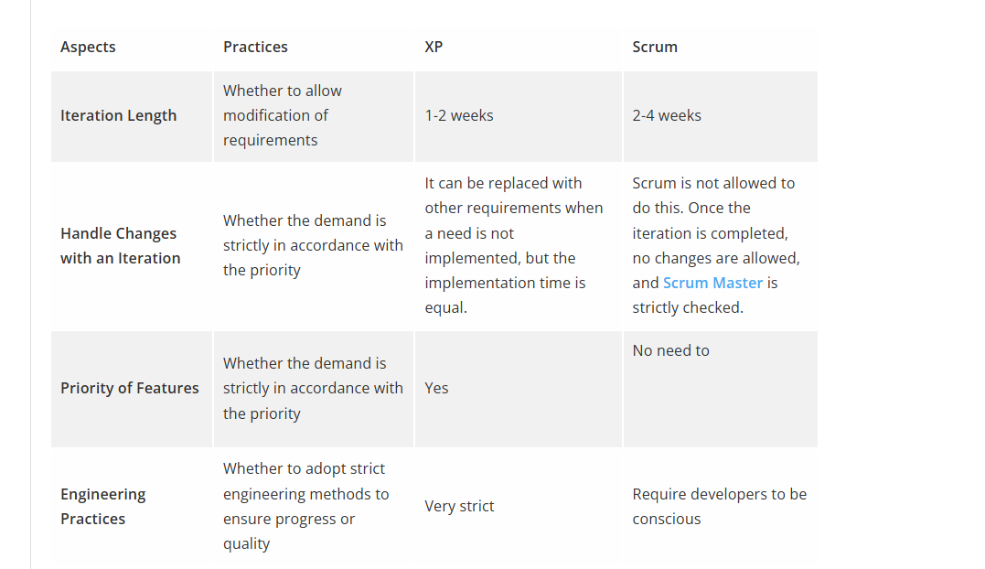

Slide 21
User stories
user stories are short requirements or requests written from the perspective of an end user.
User stories are often expressed in a simple sentence, structured as follows:
As a [persona], I [want to], [so that].
e.g. As a customer I want logo to updated so that it is visible over entire software project.

Slide 22
Write down the pros and cons of each methods.

